Slide 1
Pizza Place Sales
A year's worth of sales from a fictitious pizza place.
Dataset Link:-https://www.kaggle.com/datasets/mysarahmadbhat/pizza-place-sales
Analysis by : Anwar Ansari

Slide 2
About Dataset
A year's worth of sales from a fictitious pizza place, including the date and time of each order and the pizzas served, with additional details on the type, size, quantity, price, and ingredients.

Slide 3
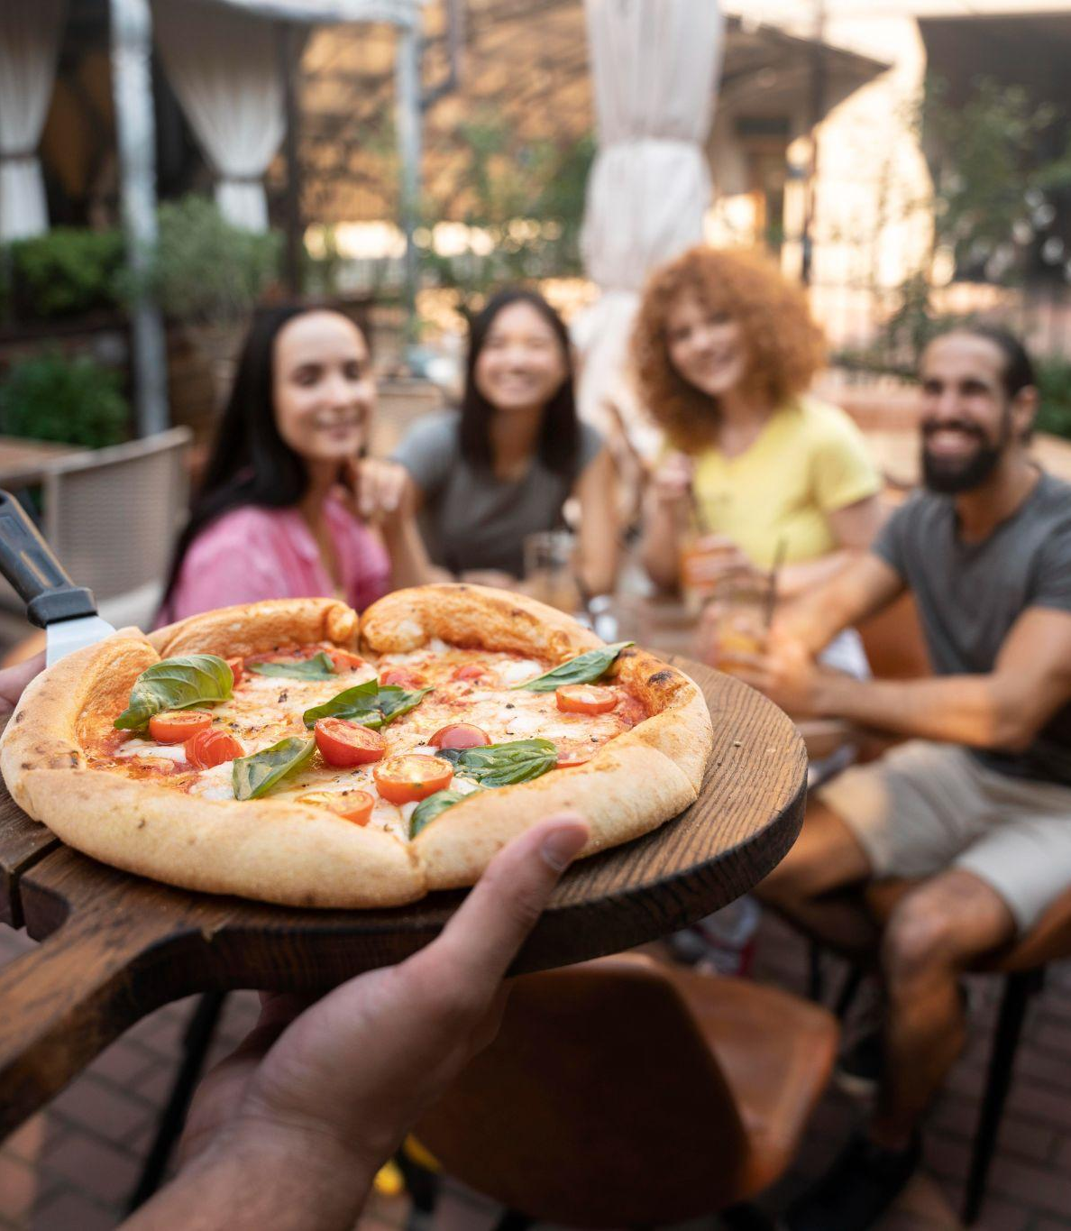
Problem:
Pizza restaurant has recently seen a decline in sales and plans to increase them by looking at customer and order data. To do this, the management plans to perform a thorough analysis of order data and consumer behavior in order to spot important trends and areas for improvement.

Slide 4
Background
An overview of pizza sales data from January 2015 to December 2015 is given in this report. To find trends and patterns in pizza sales, data was gathered from pizza joints across the United States and analyzed.

Slide 5
Recommended Analysis
How many customers do we have each day? Are there any peak hours?
How many pizzas are typically in order? Do we have any bestsellers?
How much money did we make this year? Can we identify any seasonality in the sales?
Are there any pizzas we should take off the menu, or any promotions we could leverage?

Slide 6
Recommended Analysis How many customers do we have each day?
We have 60 customers each day in 2015.
$25

Slide 7
Recommended Analysis Are there any peak hours?
Yes there is Two pear Hour in 12 Pm to 1 pm and 5 pm to 7 pm

Slide 8
Recommended Analysis How many pizzas are typically in order? Do we have any bestsellers?
The average Pizza Order is 2 and bestsellers are big_meat_s.

Slide 9
Recommended Analysis How much money did we make this year? Can we identify any seasonality in the sales?
We make in this year 351001.
Seasons | Total sale
autumn | 83571.5
Winter | 90344.15
summer | 91636.7
spring | 85448.65

Slide 10
Recommended Analysis Are there any pizzas we should take off the menu, or any promotions we could leverage?

Slide 11
Recommended Analysis More Insight Chicken and Classic are the top ingredients and large and medium size pizza are most demand.
Size | Percentage
L | 37.0%
M | 32.0%
S | 30.5%
XL | 0.5%
XXL | 0.0%
Size | Percentage
Chicken | 28.7%
Classic | 32.0%
Supreme | 19.1%
Veggie | 20.1%

Slide 12
Conclusion As we reflect on the year, it is evident that understanding customer preferences and adapting our offerings accordingly has been key to our success. The consistently high demand for certain pizza varieties, sizes, and flavors has allowed us to streamline our menu, optimize sales, and ensure a satisfying customer experience.

Slide 13
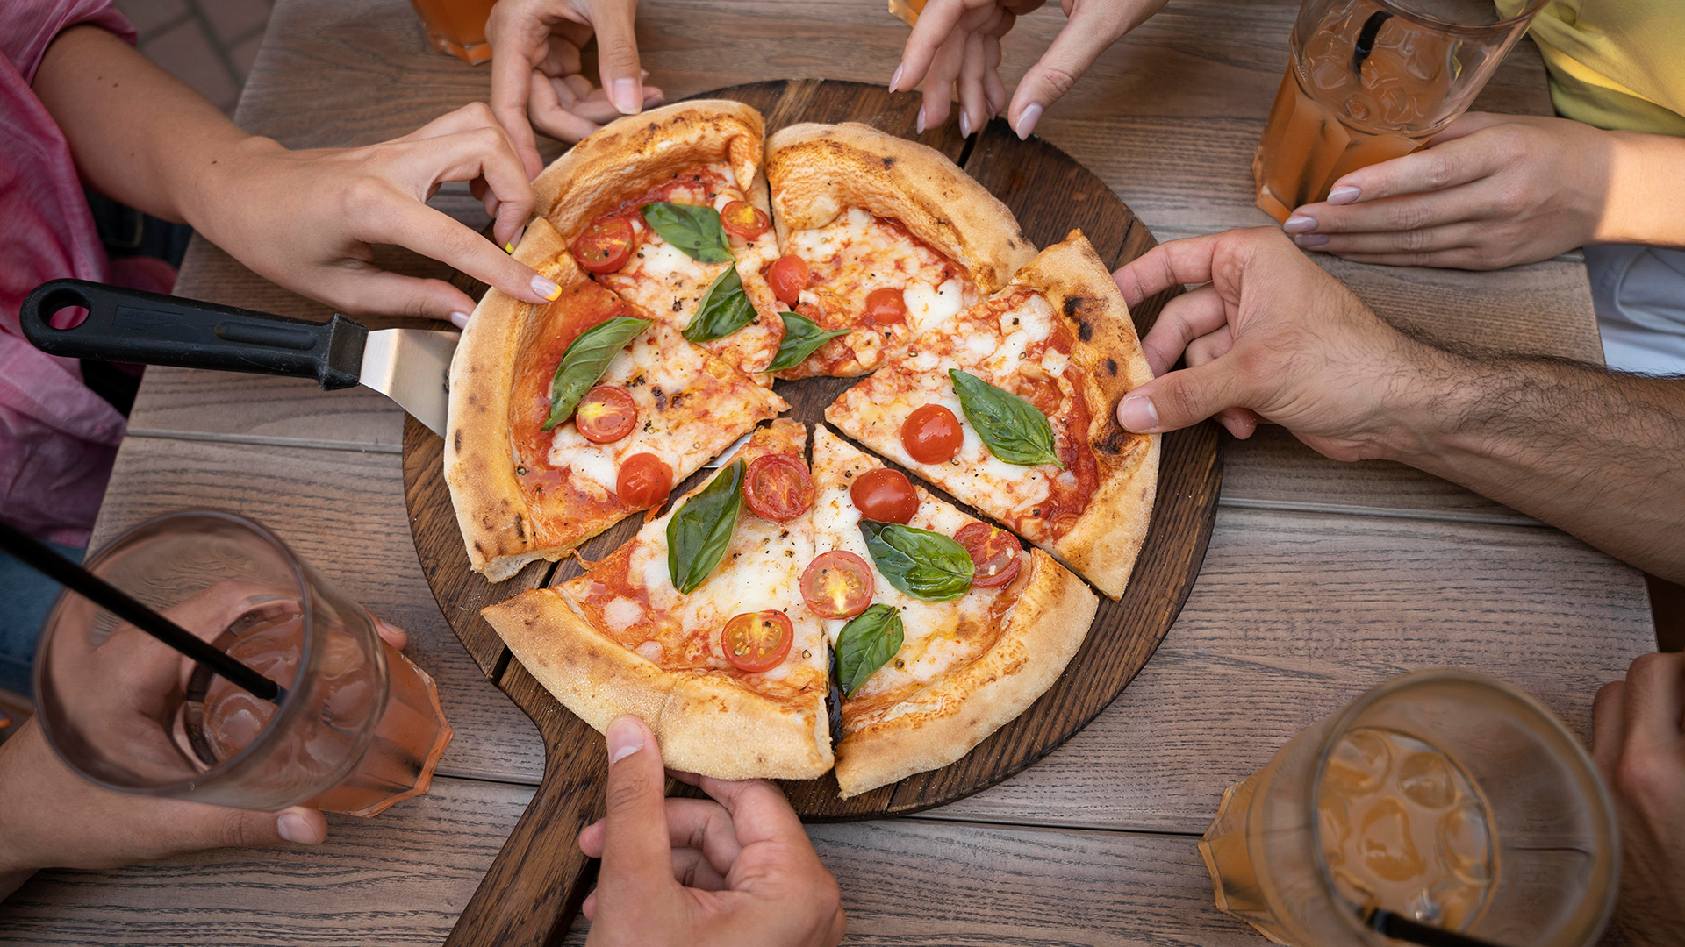
Thank You

